Slide 1


POCKET BIZZ: Empowering Small Traders
TradeTracker Pro is revolutionizing how small traders manage their business by offering a comprehensive, lightweight storefront builder coupled with advanced income and expense tracking capabilities. This full-featured application integrates cutting-edge voice and photo input to streamline operations, making financial management effortless for independent entrepreneurs.
by Collins Joshua & Victoria Atieno

Slide 2





Problem: Small Traders Lack Comprehensive Tools
Fragmented & Complex Solutions
Existing tools often require combining multiple platforms, leading to disjointed workflows and a steep learning curve for small business owners.
Time-Consuming Manual Tracking
Many traders still rely on manual methods, which are incredibly inefficient, prone to errors, and distract from core business activities.
Limited Financial Insights
Without proper tracking, small traders struggle to understand their true profitability, cash flow, and areas for potential growth or cost savings.
High Failure Rate
A staggering 65% of small businesses fail primarily due to poor financial management and lack of clear financial visibility.

Slide 3





Solution: Pocket Bizz - All-in-One Platform
Intuitive Storefront
Real-time P&L
Voice Input
Track profit and loss with automated calculations, providing instant insights into your business's financial health.
Effortlessly add data hands-free, perfect for busy traders on the go, ensuring accuracy and saving precious time.
Easily create and manage an online presence with customizable templates and simple product listings, attracting more customers.
Photo Input
Simplify receipt and inventory management by simply snapping photos, eliminating manual entry and reducing errors.

Slide 4





Key Features & Architecture
Dashboard Overview
Real-time profit/loss, sales trends, and detailed expense breakdowns at a glance, providing a comprehensive view of your business performance.
Storefront Builder
Customizable templates, easy product listings, and integrated payment processing to effortlessly establish and manage your online presence.
Income & Expense Tracking
Automated transaction imports, sales categorization, receipt photo capture, and expense type assignment for streamlined financial management.
Comprehensive Reporting
Generate detailed profitability reports, cash flow statements, and tax summaries to gain deeper insights and simplify tax preparation.
Advanced Input & Storage
Leverage Google Cloud Speech-to-Text API for 90% accurate voice input and secure, encrypted cloud storage with daily backups for peace of mind.

Slide 5








Target Market: Millions of Small Traders
Artisans & Crafters
Mobile & Market Vendors
Independent creators selling handmade goods at markets and online, needing simple inventory and sales tracking.
Food truck owners, farmers market sellers, and pop-up shop operators requiring on-the-go financial management.
Gig Workers & Freelancers
Online Retailers
Individuals in the gig economy needing efficient tools to track diverse income streams and associated expenses for tax purposes.
E-commerce businesses and dropshippers seeking an integrated solution for storefront management and financial oversight.
Our primary target market is the vast ecosystem of small businesses, a segment often underserved by complex, enterprise-level solutions. In the US alone, there are 62 million small businesses, many of whom are independent traders who will benefit immensely from a tailored, user-friendly platform. We focus on empowering these entrepreneurs to manage their finances effectively without needing extensive accounting knowledge.

Slide 6
Competitive Advantages
All-in-One Solution
Innovative Input Methods
User-Friendly & Affordable
Unlike fragmented tools, TradeTracker Pro integrates storefront creation with comprehensive income and expense tracking into a single, seamless platform.
Our unique voice and photo input capabilities drastically increase efficiency, allowing for hands-free data entry and quick receipt digitization.
TradeTracker Pro is designed with non-technical users in mind, boasting an intuitive interface and an affordable pricing structure.
This eliminates the need for multiple subscriptions and complex data synchronization, saving time and reducing operational overhead for small traders.
This sets us apart from competitors, providing a user experience that is both intuitive and exceptionally convenient, especially for busy entrepreneurs.
We are approximately 30% cheaper than QuickBooks alternatives and offer up to 50% faster data entry compared to manual tracking, delivering superior value.

Slide 7
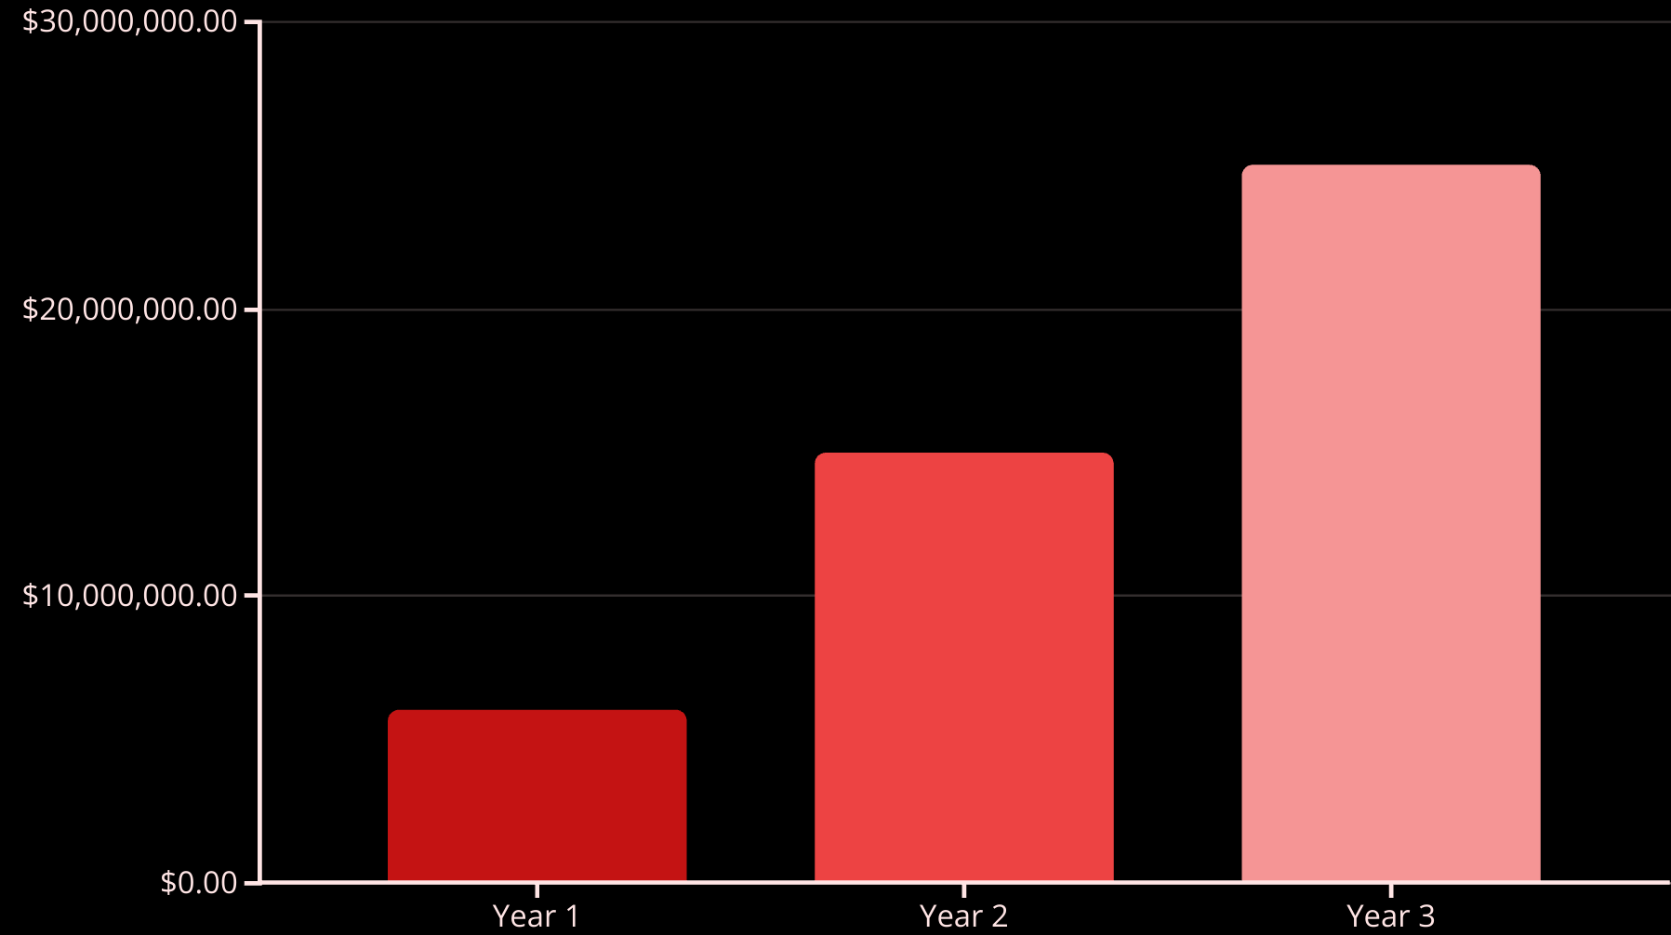
Business Model & Revenue Projections
Our business model leverages a freemium strategy, offering essential features for free to attract a broad user base. Advanced functionalities, such as detailed reporting, CRM integrations, and premium storefront templates, will be available through flexible subscription plans. We project to acquire 10,000 paying subscribers in our first year, with an average revenue per user of $50 per month, leading to a Year 1 revenue of $6 million. By Year 3, we anticipate reaching $25 million in revenue as our user base expands and our platform scales.

Slide 8
Call to Action: Invest in Pocket Bizz
Seed Funding Opportunity
Experienced Team
High-Growth Potential
Market Disruption
We are seeking $1 million in seed funding to accelerate product development, enhance marketing efforts, and expand our operational capacity.
Our team comprises seasoned professionals with a proven track record in software development, financial technology, and market penetration.
We are poised to disrupt the small business management market by offering a unique, integrated solution that addresses core pain points.
Our scalable platform and large target market provide significant opportunities for rapid growth and substantial returns on investment.
TradeTracker Pro is more than just an application; it's a strategic investment in the future of small business. By empowering millions of independent traders with intuitive, comprehensive tools, we are not only building a successful company but also fostering economic growth and entrepreneurial success. Join us in revolutionizing small business management.

